Slide 1
Poi tracker
{{Austin,White}, {Sierra, Wyllie}};
CPS;
Print[DateObject[]];

Slide 2
Layout
Description
Pipeline
Camera Face Recognition
Nodes and Command Line Interfacing
Face Identification
Neural Network
PostgreSQL
Why Node1?
What We’ve Learned

Slide 3
Description

Slide 4
Objective
Identify a person’s name by their face.
Uses Computer Vision, face recognition, and face identification.
Utilizes AI (Artificial Intelligence).

Slide 5
GUI
(Graphical User Interface)
Allows user to identify a face from IPWebCam, a .jpg image, or their laptop camera.
Also allows user to refresh the server in order to keep the application running smoothly.
Still need to do some final formatting, such as adding a user help page.

Slide 6
Pipeline
How we structured our project.

Slide 7
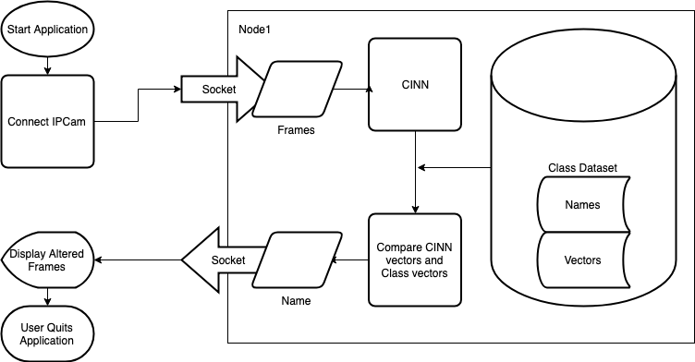
Faces from camera streamed into Mathematica on Cloud Lab node1.
Faces used for facial identification against our dataset, which currently includes our classmates and teachers.
Person’s name (if successfully identified) sent back to local machine (laptop) for display in app alongside full image and a box bounding the face.

Slide 8
Local work
The GUI lets user choose how they will identify a face
Fetches images, FindsFaces, then Rasterizes the faces in preparation for transmission to node1.

Slide 9
Nodes and command line interfacing
The brunt of the project is remotely done.
We connect to the WKU Cloud Lab (COHH 2101) node1 via Sockets, which are maintained in background.
node1 runs Mathematica from command line (terminal)
node1 identifies the face and returns the name to the laptop.

Slide 10
Face identification
How we identify.

Slide 11
Ai / computer vision
AI mimics human intelligence.
Useful in Pattern Recognition (for data) and Computer Vision (making computers see like we do)
Computer Vision in faces
Face Authentication, verifies identity and that the face is real
Face Recognition, identifies object as a face
Face Identification, identifies person from face
Convoluted Neural Networks (CNNs)

Slide 12
CINN
Start
End
Convoluted Inception Neural Network (CINN) (Inspired by GoogLeNet)
Contains two layers of inceptions.
Trained on CASIA and FaceScrub datasets.

Slide 13
Postgre sql Database
Used to compare the faces from frames to classmates in order to find the closest match
1112 images of classmates and teachers
Roughly 3 GB of raw data

Slide 14
Why node1?
Scalability
Speed
PostgreSQL computation (45 minutes vs. 5 hours)
CINN computation
Socket computation

Slide 15
AI
Neural nets
Convolution layers
TCP connections
Sockets
RunProcess
PostgreSQL
Unix command line
Windows command line/WinSCP/Putty
tmux (unix command)
Port-forwarding
Client-server relationships
Database management
Database generation
Manually adding Ubuntu dependency libraries
Command line Mathematica
.wls scripts (Wolfram Language Scripts)
What we’ve Learned

Slide 16
One big failure
Training our own CINN!
Mathematica 11 and 12 are not yet powerful enough for training inception networks.
We are still investigating CINN and the training scheme.

Slide 17
Demos
Database
GUI/server

